Slide 1
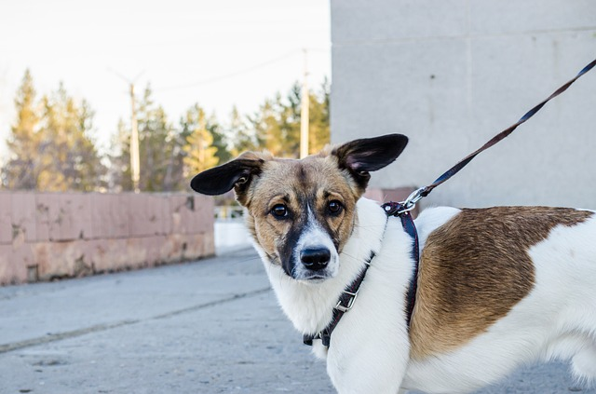
Week 1 honden - dag 2 sorteerspel: is dit dier aan de lijn?
Foto 1.1
Notes:
Bron: http://pixabay.com/en/dog-pet-dog-on-a-leash-nature-city-323895/
Auteur: thephilippena http://pixabay.com/en/users/thephilippena/
Licentie: Public Domain CC0

Slide 2
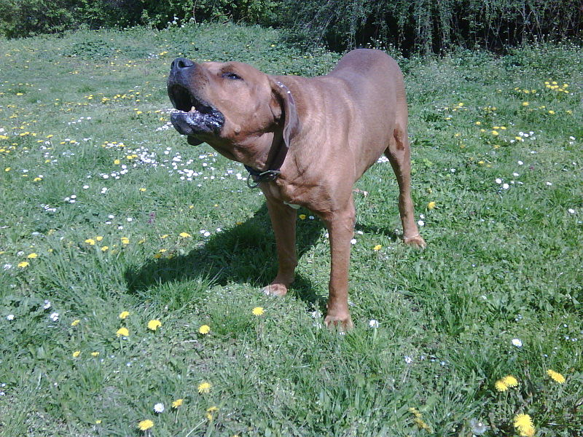
Week 1 honden – dag 2 sorteerspel: is dit dier aan de lijn?
Foto 1.2
Notes:
Bron: http://en.wikipedia.org/wiki/Dog_aggression#mediaviewer/File:Janev_Boss.jpg
Auteur: Gaga999 http://commons.wikimedia.org/w/index.php?title=User:Gaga999&action=edit&redlink=1
Licentie: Creative Commons Attribution-Share Alike 3.0 Unported

Slide 3
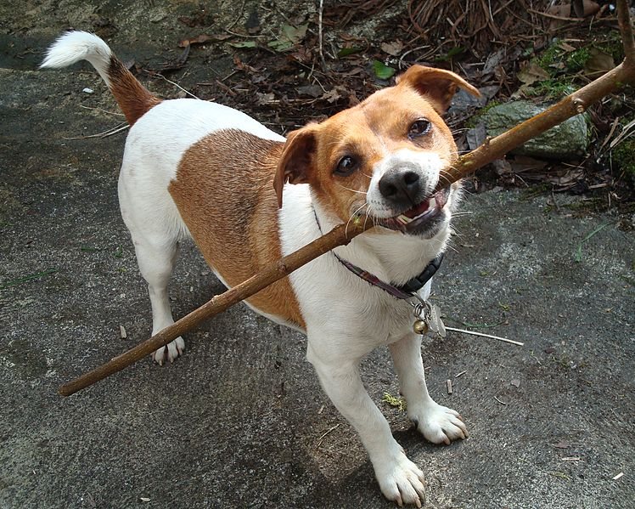
Week 1 honden - dag 2 sorteerspel: is dit dier aan de lijn?
Foto 1.3
Notes:
Bron: http://commons.wikimedia.org/wiki/File:Dog_on_a_Stick_%282483492371%29.jpg
Auteur: Spider.Dog http://www.flickr.com/people/88728149@N00
Licentie: Creative Commons Attribution 2.0 Generic

Slide 4
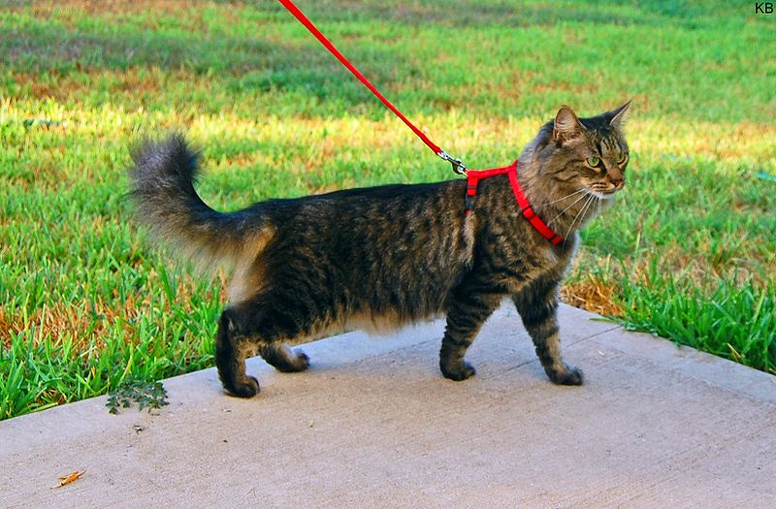
Week 1 honden – dag 2 sorteerspel: is dit dier aan de lijn?
Foto 1.4
Notes:
Bron: http://commons.wikimedia.org/wiki/File:Cat_harness_and_leash.jpg
Auteur: K B https://www.flickr.com/photos/28284386@N02
Licentie: Creative Commons Attribution 2.0 Generic

Slide 5
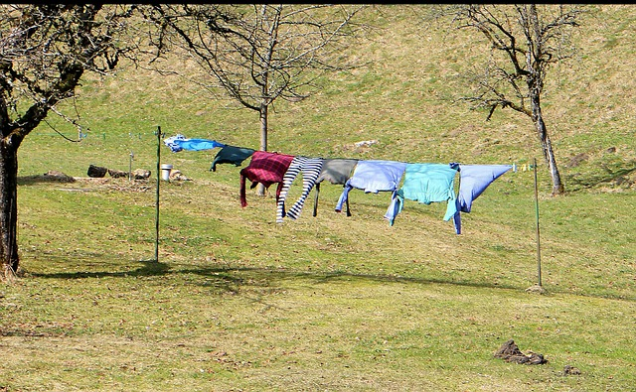
Week 1 honden - dag 2 sorteerspel: is hier een dier aan de lijn?
Foto 1.5
Notes:
Bron:http://pixabay.com/en/laundry-leash-garments-dry-291168/
Auteur: Antranias http://pixabay.com/en/users/Antranias/
Licentie: Public Domain CC0

Slide 6
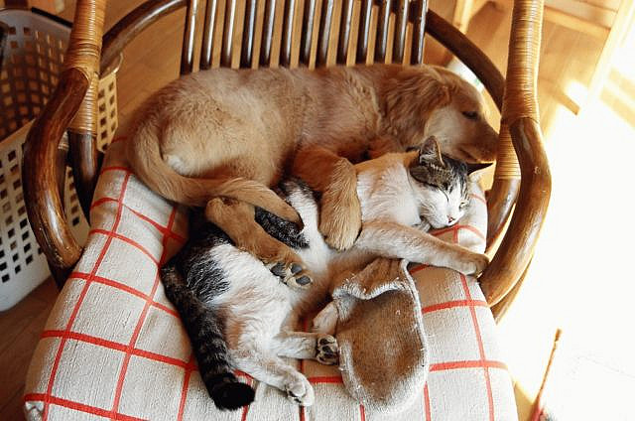
Week 1 honden - dag 2 sorteerspel: zijn deze dieren aan de lijn?
Foto 1.6
Notes:
Foto rechts boven:
Bron: https://www.flickr.com/photos/fiatpanda/3512331959/in/photostream/
Auteur: K B https://www.flickr.com/photos/28284386@N02
Licentie: Creative Commons Attribution 2.0 Generic

Slide 7
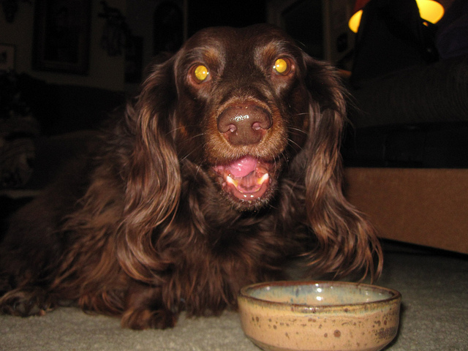
Week 1 honden - dag 2 sorteerspel: is de hond aan de lijn?
Foto 1.7
Notes:
Bron: https://flic.kr/p/bHxeTn
Auteur: Tony Alter http://www.flickr.com/photos/78428166@N00/
Licentie: https://creativecommons.org/licenses/by-sa/2.0/

Slide 8
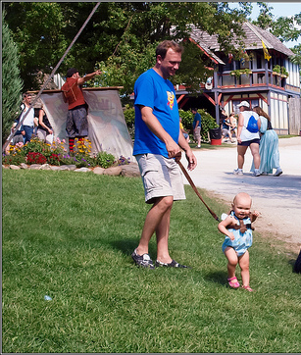
Week 1 honden – dag 2 sorteerspel: is hier iemand aan de lijn?
Foto 1.8
Notes:
Bron: http://www.flickr.com/photos/theeerin/4897400997/in/photolist-8sLsGe-dGx28T-6q5poe-fa4rJ8-mg9iUW-6uY7fi-bhvUZr-fNhtv-dZyGa-6hteyR-8iCiVx-NZmPW-6ykaCt-7J1brW-depXnU-4uYd2z-aEDYdM-dfBj6-4PPZmL-8hsHy1-8Bbjeh-8Bbj8s-66EgrJ-8HTERX-m7HJN-JWJKc-i24ELd-Wk5JU-3hRhPp-9bjHqF-vT5Sy-2EprYP-6EmfZ5-3g5Kwp-8B8c8r-gU57Yn-324c2w-eMfWH-4FtNXR-o6T83b-nSoPfr-32xAad-dty5X-evrCB9-ooZrHH-opfxrN-oej1qK-oGDTHF-6WxTca-6mHezU
Auteur: TheeErin https://www.flickr.com/photos/theeerin/
Licentie: https://creativecommons.org/licenses/by-sa/2.0/

Slide 9
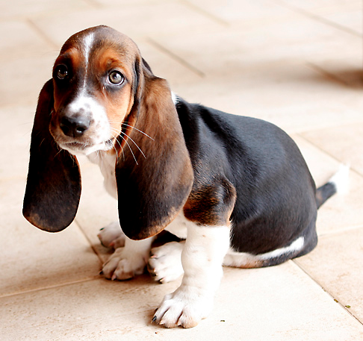
Week 1 honden – dag 4 sorteerspel: wie is volwassen?
Foto 1.9
Notes:
Foto links boven: http://en.wikipedia.org/wiki/Puppy#mediaviewer/File:Cara_de_quem_caiu_do_caminh%C3%A3o..._%28cropped%29.jpg
Bron:http://pixabay.com/en/laundry-leash-garments-dry-291168/
Auteur: Anderson Nascimento http://flickr.com/photos/51924844@N00
Licentie:Creative Commons Attribution 2.0 Generic

Slide 10
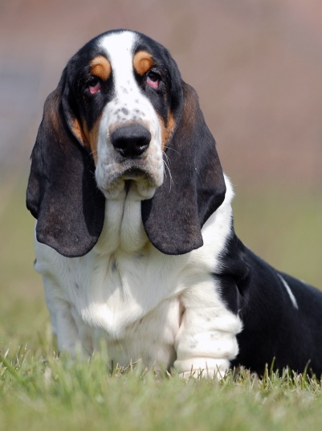
Week 1 honden – dag 4 sorteerspel: wie is volwassen?
Foto 1.10
Notes:
Bron: http://en.wikipedia.org/wiki/Basset_Hound#mediaviewer/File:Bvdb-bassethound1.jpg
Auteur: Bonnie van den Born, http://www.bonfoto.nl
Licentie: Foto is gedoneerd door de fotograaf en vrij te gebruiken onder vermelding van de bron: http://www.bonfoto.nl. Toestemming voor publicatie onder GFDL of CC-BY-SA-2.5-NL is vastgelegd in nl:Wikipedia:De kluis

Slide 11
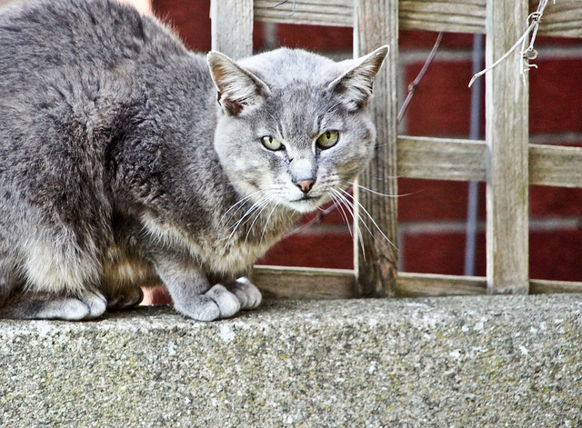
Week 1 honden – dag 4 sorteerspel: wie is volwassen?
Foto 1.11
Notes:
Bron:https://www.flickr.com/photos/infomatique/5370763449/
Auteur: William Murphy https://www.flickr.com/photos/infomatique/
Licentie: https://creativecommons.org/licenses/by-sa/2.0/

Slide 12
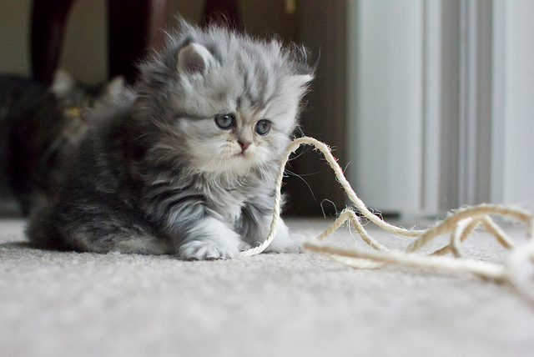
Week 1 honden – dag 4 sorteerspel: wie is volwassen?
Foto 1.12
Notes:
Bron: https://www.flickr.com/photos/albaraa/7837153986/
Auteur: Belal Khan https://www.flickr.com/photos/albaraa/
Licentie: https://creativecommons.org/licenses/by/2.0/
Auteur: Tony Alter http://www.flickr.com/photos/78428166@N00/
Licentie: https://creativecommons.org/licenses/by-sa/2.0/

Slide 13

Week 1 honden – dag 4 sorteerspel: wie is volwassen?
Foto 1.13
Notes:
Bron: http://pixabay.com/en/man-person-business-businessman-319286/
Auteur: africaniscool http://pixabay.com/en/users/africaniscool/
Licentie: Public Domain CC0

Slide 14
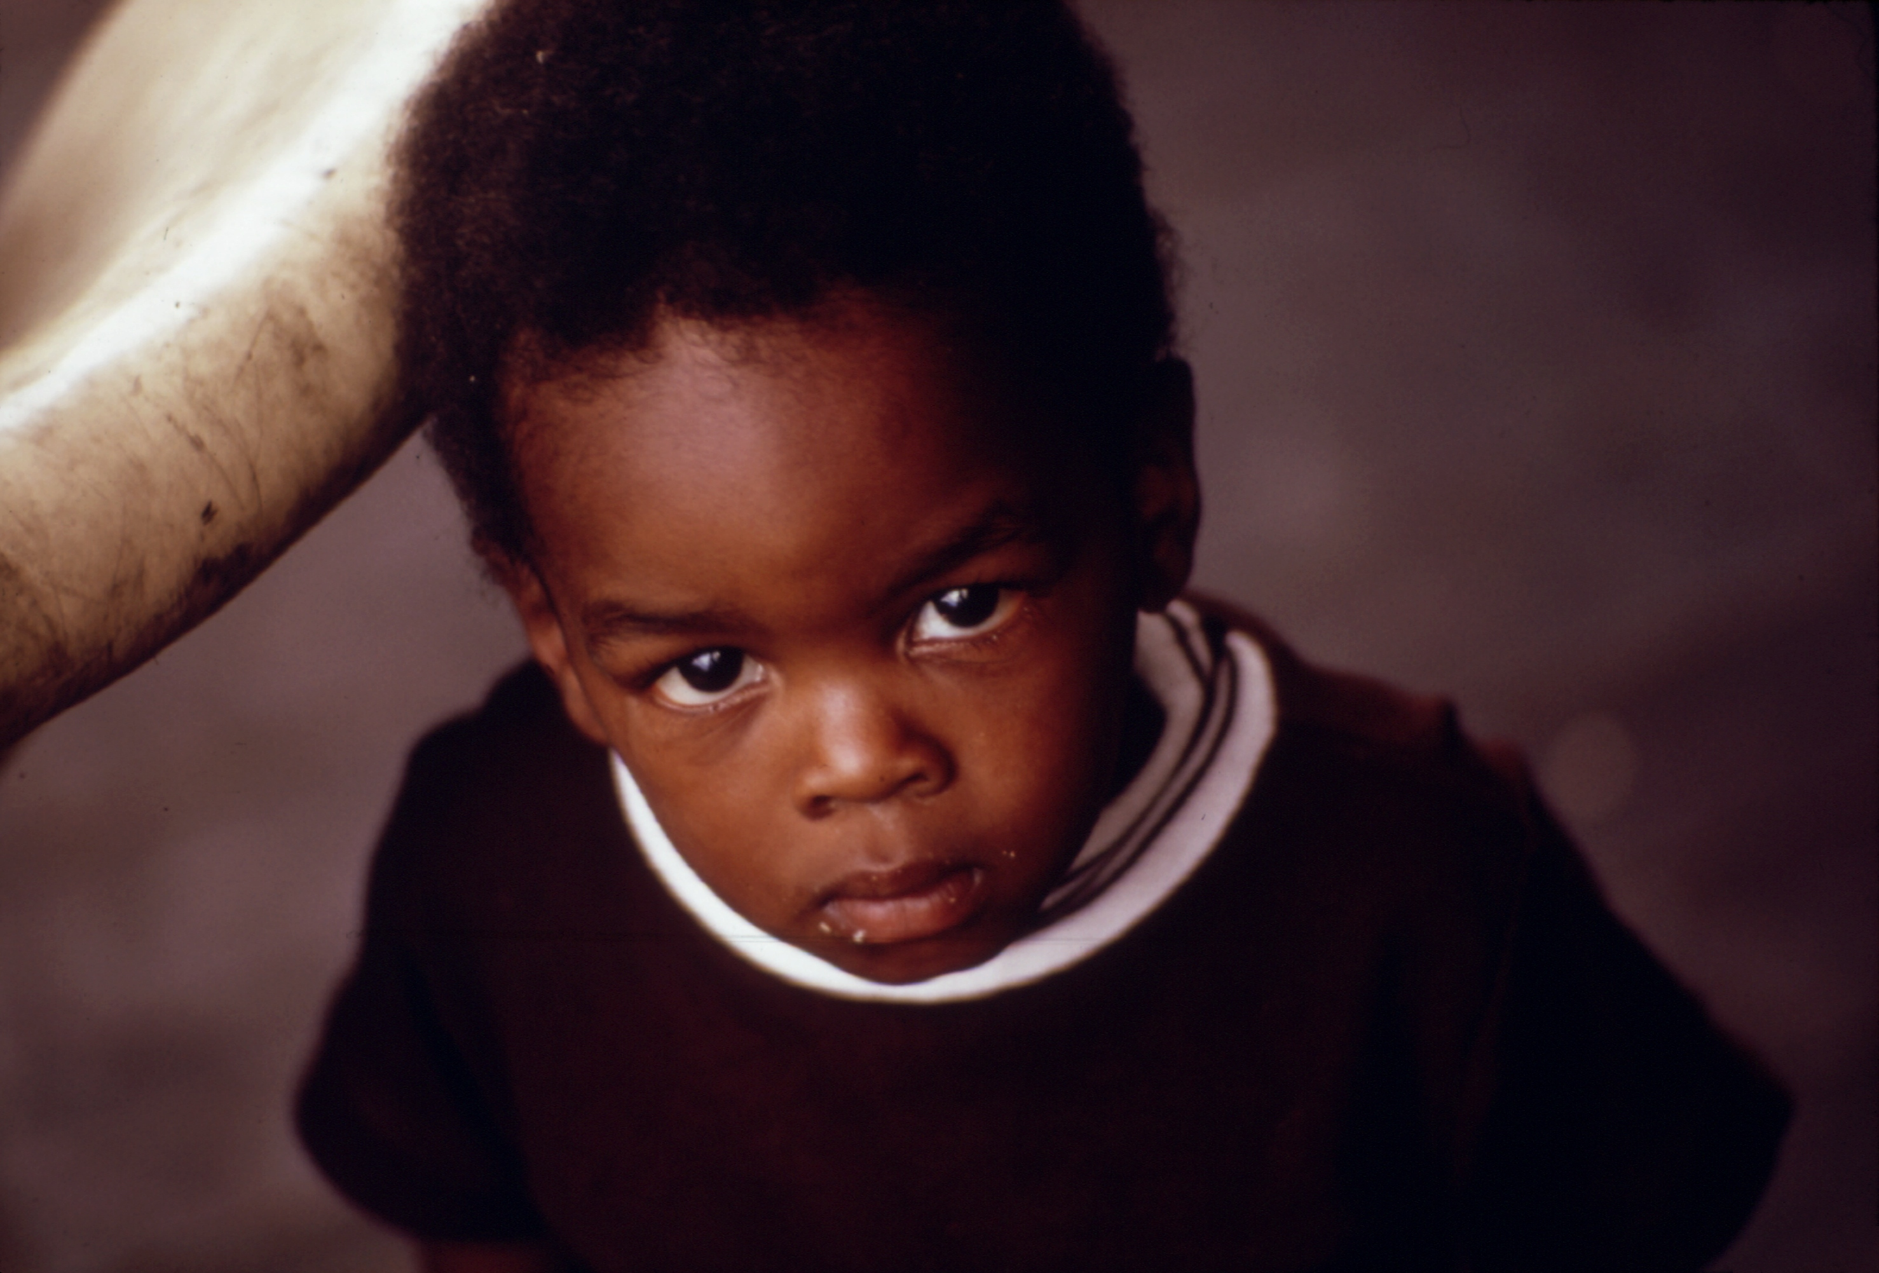
Week 1 honden – dag 4 sorteerspel: wie is volwassen?
Foto 1.14
Notes:
Bron: http://commons.wikimedia.org/wiki/File:A_black_child,_Chicago._-_NARA_-_556138_restored.jpg
Auteur: John H. White http://research.archives.gov/person/4002141
Licentie: This work is in the public domain in the United States because it is a work prepared by an officer or employee of the United States Government as part of that person’s official duties under the terms of Title 17, Chapter 1, Section 105 of the US Code. See Copyright.

Slide 15
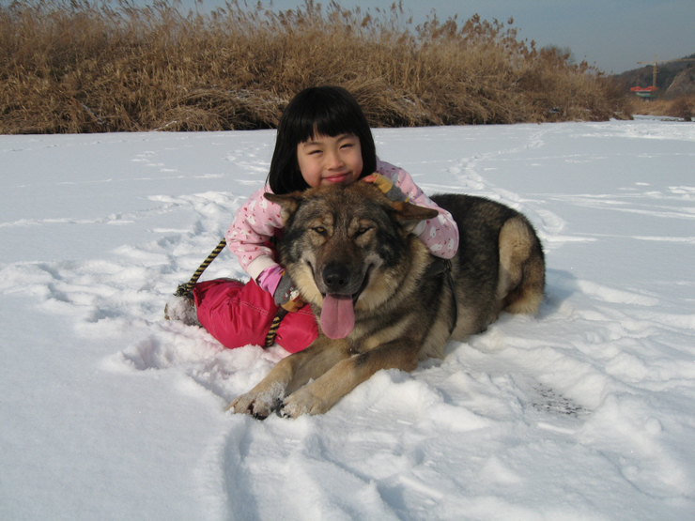
Week 1 honden – dag 4 sorteerspel: wie is tam?
Foto 1.15
Notes:
Bron: http://commons.wikimedia.org/wiki/File:Dog_on_a_Stick_%282483492371%29.jpg
Auteur: Spider.Dog http://www.flickr.com/people/88728149@N00
Licentie: Creative Commons Attribution 2.0 Generic

Slide 16
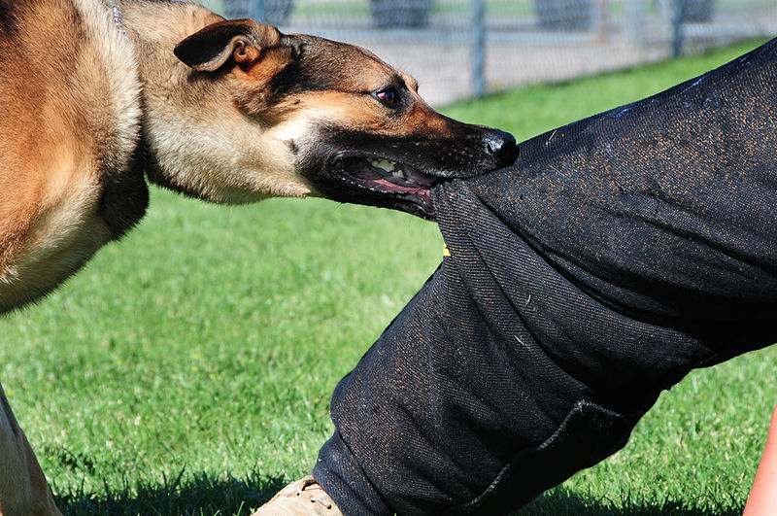
Week 1 honden – dag 4 sorteerspel: wie is tam?
Foto 1.16
Notes:
Foto rechts onder:
Bron: http://commons.wikimedia.org/wiki/File:Ellsworth_dog_bite.JPG
Auteur: U.S. Air Force photo/Airman 1st Class Anthony Sanchelli
Licentie: This image or file is a work of a U.S. Air Force Airman or employee, taken or made as part of that person's official duties. As a work of the U.S. federal government, the image or file is in the public domain.

Slide 17
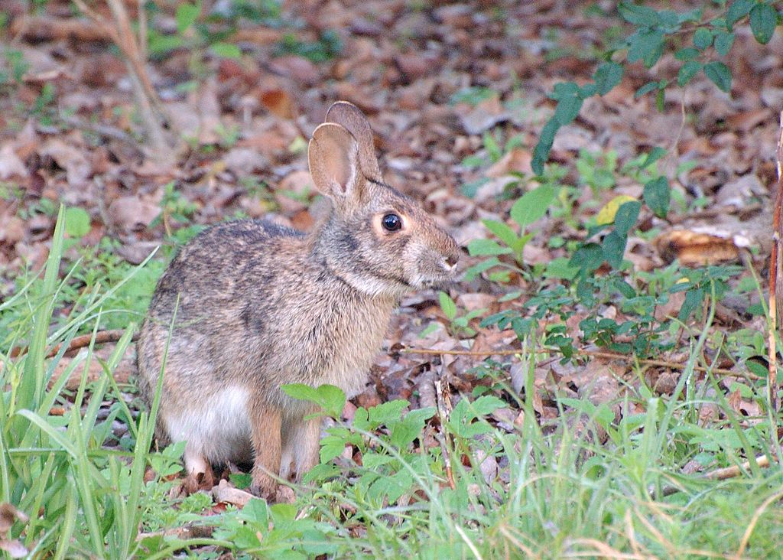
Week 1 honden – dag 4 sorteerspel: wie is tam?
Foto 1.17
Notes:
Foto links boven:
Bron: http://en.wikipedia.org/wiki/Swamp_rabbit#mediaviewer/File:Swamp_Rabbit_%28Sylvilagus_aquaticus%29.jpg
Auteur: glenn_e_wilson http://www.flickr.com/photos/85328063@N00
Licentie: http://creativecommons.org/licenses/by/2.0
Licentie: https://creativecommons.org/licenses/by-sa/2.0/

Slide 18
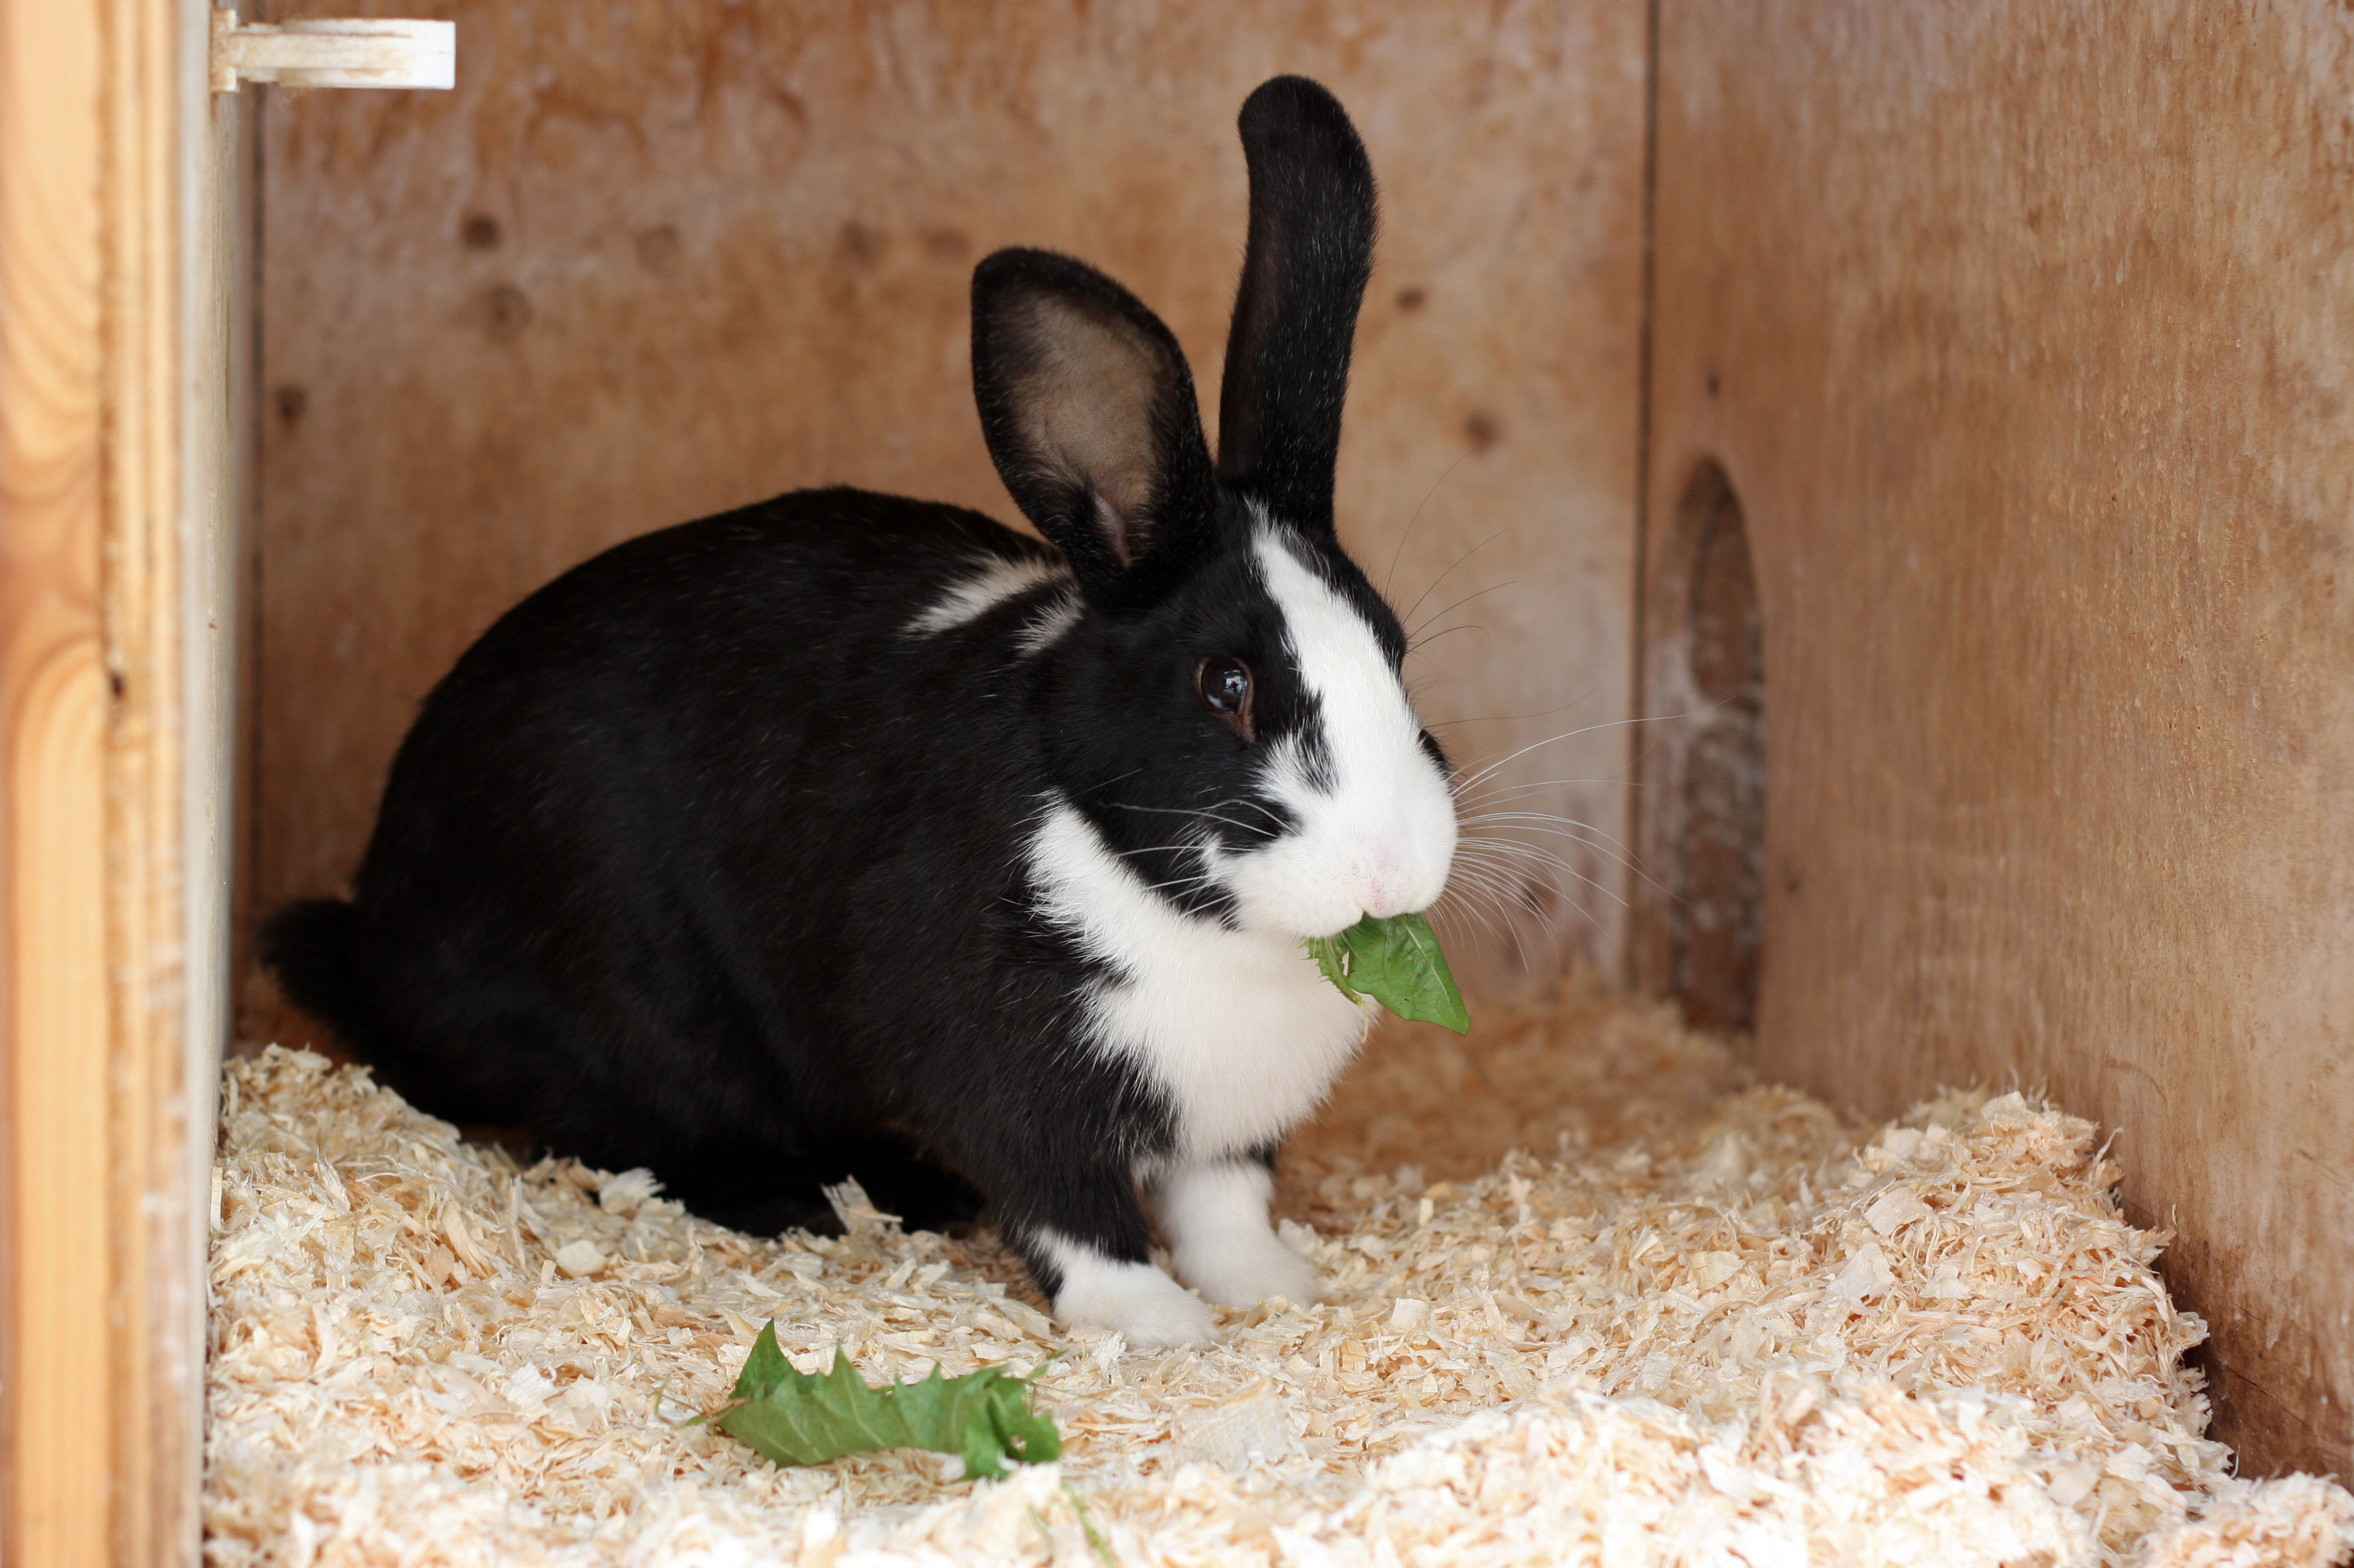
Week 1 honden – dag 4 sorteerspel: wie is tam?
Foto 1.18
Notes:
Bron: http://en.wikipedia.org/wiki/Mellerud_rabbit#mediaviewer/File:Mellerud_rabbit.jpeg
Auteur: Galleytrotter http://commons.wikimedia.org/w/index.php?title=User:Galleytrotter&action=edit&redlink=1
Licentie:Creative Commons Attribution-Share Alike 3.0 Unported

Slide 19
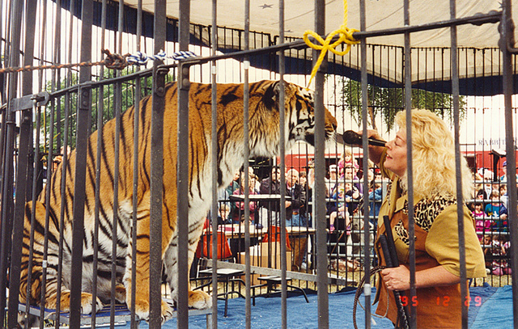
Week 1 honden – dag 4 sorteerspel: wie is tam?
Foto 1.19
Notes:
Bron: https://www.flickr.com/photos/24736216@N07/5017042753/
Auteur: Roger Wollstadt https://www.flickr.com/photos/24736216@N07/
Licentie: https://creativecommons.org/licenses/by-sa/2.0/

Slide 20
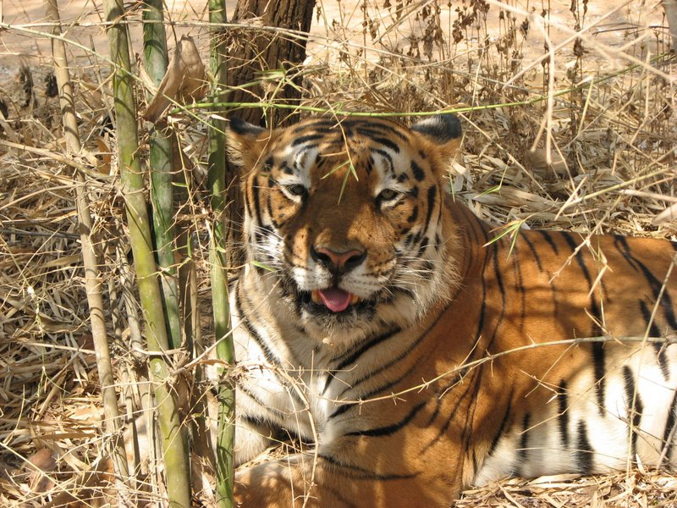
Week 1 honden – dag 4 sorteerspel: wie is tam?
Foto 1.20
Notes:
Bron:http://commons.wikimedia.org/wiki/File:Indian_Tiger.jpg
Auteur: Atul.lonkar http://commons.wikimedia.org/w/index.php?title=User:Atul.lonkar&action=edit&redlink=1
Licentie:Creative Commons Attribution-Share Alike 3.0 Unported

Slide 21
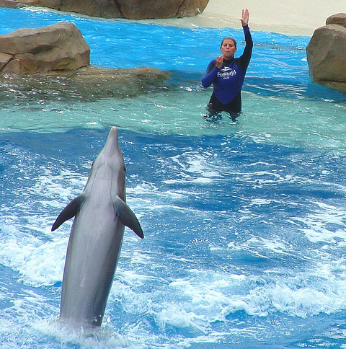
Week 1 honden – dag 4 sorteerspel: is hier een dierenarts?
Foto 1.21
Notes:
Bron: https://www.flickr.com/photos/rosshawkes/5549348211/
Auteur: Ross Hawkes https://www.flickr.com/photos/rosshawkes/
Licentie:https://creativecommons.org/licenses/by/2.0/

Slide 22
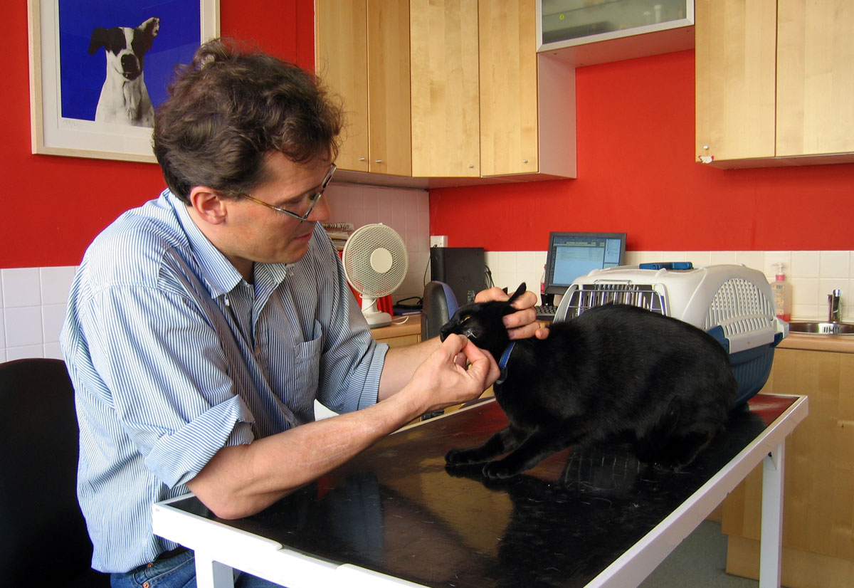
Week 1 honden – dag 4 sorteerspel: is hier een dierenarts?
Foto 1.22
Notes:
Bron: http://commons.wikimedia.org/wiki/File:Veterinary_Surgeon.jpg
Auteur: Andrew Dunn, http://www.andrewdunnphoto.com/
Licentie:Creative Commons Attribution-Share Alike 2.0 Generic

Slide 23
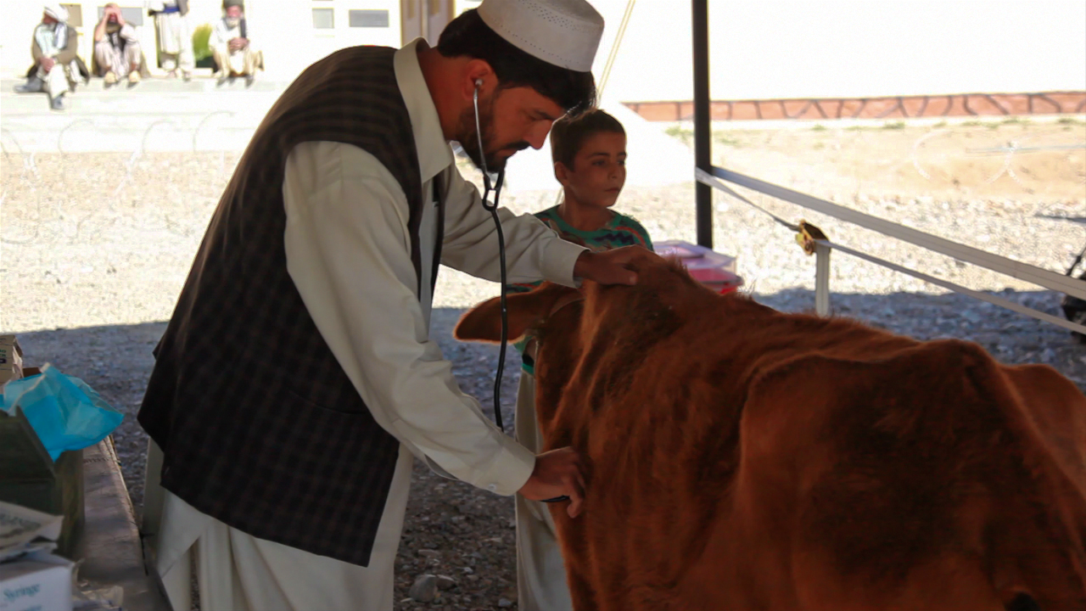
Week 1 honden – dag 4 sorteerspel: is hier een dierenarts?
Foto 1.23
Notes:
Bron: http://commons.wikimedia.org/wiki/File:Afghan_Vet_Assessing_Health_of_Cow.jpg
Auteur: U.S. Army via ISAFmedia
Licentie:This image is a work of a U.S. Army soldier or employee, taken or made as part of that person's official duties. As a work of the U.S. federal government, the image is in the public domain.

Slide 24
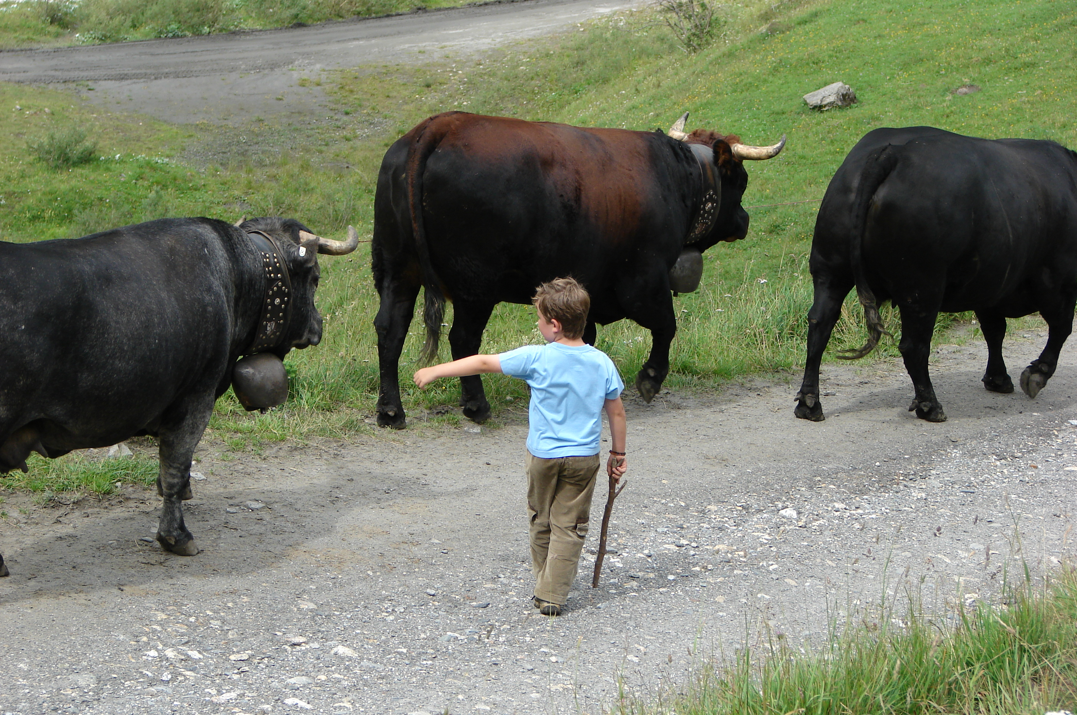
Week 1 honden – dag 4 sorteerspel: is hier een dierenarts?
Foto 1.24
Notes:
Bron:http://www.freeimages.com/photo/861993
Auteur: lvklaveren http://www.freeimages.com/profile/lvklaveren
Licentie: http://www.freeimages.com/help/7_2

